Slide 1
Performance via Complexity
© 2018 L. V. Kale at the University of Illinois Urbana-Champaign

Slide 2
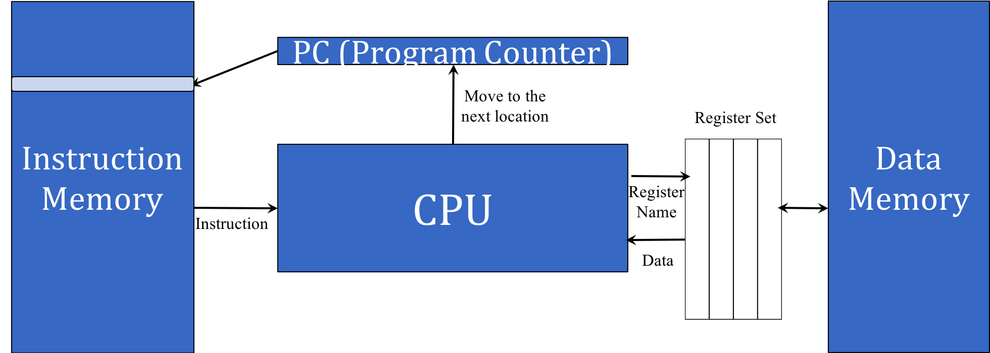
Obstacles to Speed
What are the possible obstacles
to speed in this design?
Long chain of gate delays
“Floating point” computations
Slow… I mean really S…l…o…w memory!
Virtual memory and paging
The theme for this module:
Overcoming these obstacles can lead to significant increase in complexity, and can make performance difficult to predict and control

Slide 3
Latency vs. Throughput and Bandwidth
Imagine you are putting a fire out
Only buckets, no hose
100 seconds to walk with a bucket from water to fire (and 100 to walk back)
But if you form a bucket brigade
(Needs people and buckets)
You can deliver a bucket every 10 seconds
So, latency is 100 or 200 seconds, but throughput/bandwidth is 0.1 buckets per second… much better
What’s more, you can increase bandwidth:
Just make more lines of bucket brigade

Slide 4
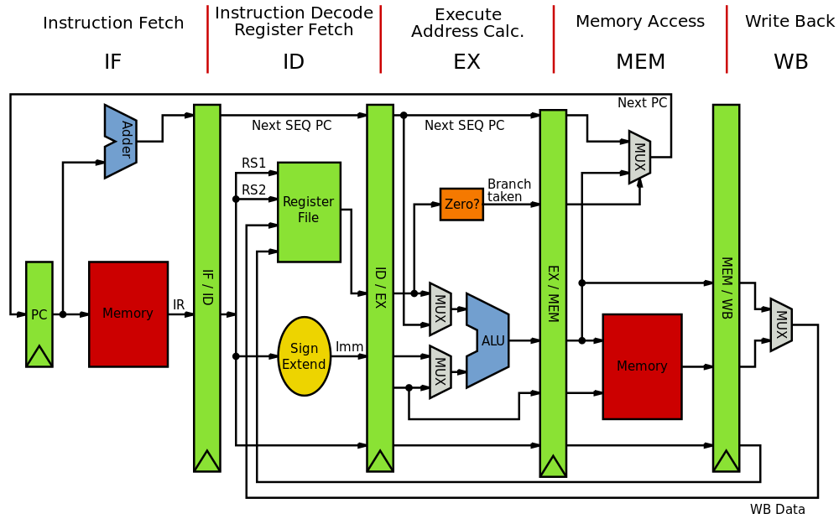
Reducing Clock Period – Pipelining
Notes:
Source: wikibooks.org - open source – no citation needed.

Slide 5
Pipelined Processor
Allows us to reduce the clock period
Since long gate delay (critical paths) are reduced
But assumes we can always pipeline instructions
What can disturb a pipeline?
Hazards (may create “bubbles” in the pipeline)
Data hazard: instruction, which needs a result calculated by a previous instruction
Control hazard: branches and Jumps

Slide 6
Avoiding Pipeline Stalls
Data forwarding:
In addition to storing the result in a register, forward it to the next instruction (store it in the pipelines buffer)
Dynamic branch prediction:
Separate hardware units that track branch statistics, and predict which way a branch will go!
E.g., a loop: branch will go back in all cases, except the last

Slide 7
Impact of Branch Prediction on Programming
Consider the following code
Assume data contains random numbers between 0..255, and the arraySize is 32k
It was observed that sorting the data beforehand improves the performance five-fold
Why?
Potential answer: every “if” in the above is unpredictable, but with sorted data they are statistically predictable
(false, false, … false, true, true, … true)
for (unsigned c = 0; c < arraySize; ++c)
{ if (data[c] >= 128) sum += data[c]; }
(stackoverflow.com, n.d.)

Slide 8
Programming to Avoid Branch Misprediction
When you have data dependent branches that are hard to predict:
See if you can convert them into non-branching code!
Conditional move instructions help, and normally compilers should do the right thing, but sometimes compilers aren’t able to
Suggestion from stackoverflow: subtract 128, shift sign-bit, negate
for (unsigned c = 0; c < arraySize; ++c) { if (data[c] >= 128) sum += data[c]; }
for (unsigned c = 0; c < arraySize; ++c)
{int t = (data[c] - 128) >> 31;
sum += ~t & data[c];}

Slide 9
Programming to Avoid Branch Misprediction
When you have data dependent branches that are hard to predict:
See if you can convert them into non-branching code!
Conditional move instructions help, and normally compilers should do the right thing, but sometimes compilers aren’t able to
For example:
Sum += expression that evaluates to data[c] if > 128 or 0 otherwise;
Or, since there are only 255 possible values, pre-create a lookup table
Sum += table[data[c]];

Slide 10
Floating Point Operations
A multiply and add is needed together in many situations
DAXPY: double-precision Alpha X Plus Y
for (i=0; i<N; i++) Y[i] = a*X[i] + Y[i];
Special hardware units that can do the two together
And, of course, it is pipelined
When there are enough such operations in sequence, the pipeline is full, and you get two floating point ops per cycle
Machines support a FMAD instruction (saves instruction space)

Slide 11
References
Stack overflow. (n.d.). Why is it faster to process a sorted array than an unsorted array? Retrieved from https://stackoverflow.com/questions/11227809/why-is-it-faster-to-process-a-sorted-array-than-an-unsorted-array

